Slide 1
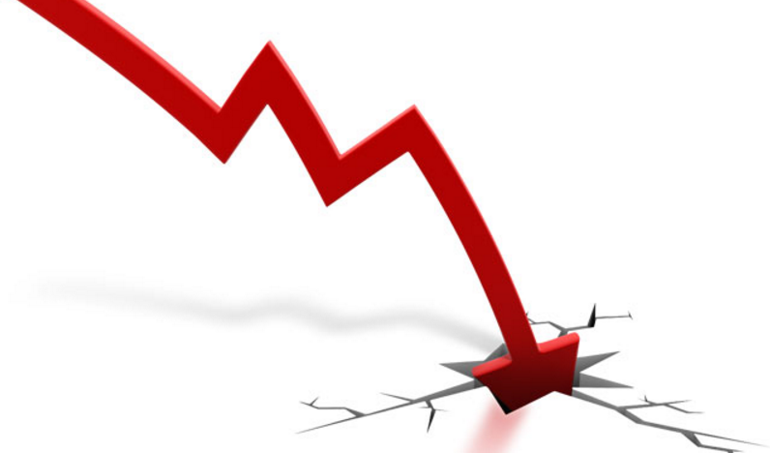
Predicting Profit Warnings
NLP applied to conference call transcripts analysis

Slide 2
1. What is a Profit Warning?
2. Web scraping: The Quest for Data
3. EDA and New Features Engineering
4. Machine Learning – Testing Models
5. Machine Learning – Ensemble
6. Answers & Work in Progress

Slide 3
1. What is a Profit Warning?

Slide 4
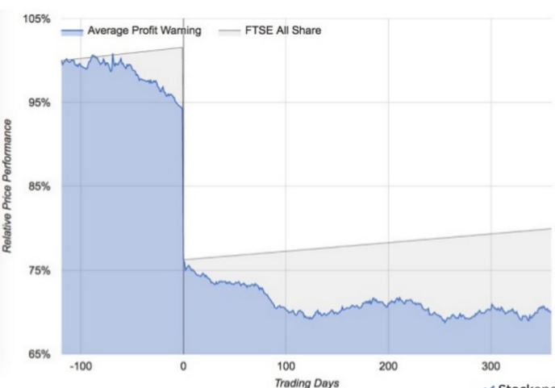
What is a Profit Warning?
PROFIT WARNING
When a company advises its earnings will not meet analyst expectations.
Profit warnings happens 2 or more weeks before earnings announcement.
6 months before investors are already pricing some profit warning risk
Profit warning day might come with more than 20% loss.
Underperformance persists in the long term.
-20% Average Loss PW day
PW announcement

Slide 5
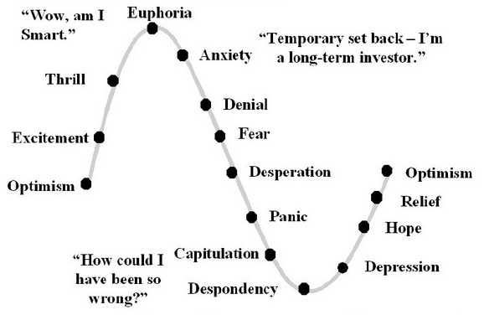
Profit Warnings and NLP: Connecting The Dots
NLP meets Behavioural Finance
Negative Tone in conference calls take time to reflect in price (cognitive dissonance).
Watch for differences in tone between analysts and management.
Readability indices helping to understand event probability.
Myopic short-term vocabulary always a bad a omen.
Conference length always a good predictor of trouble.
Short Q&A session despite analysts interest (lack of willingness to answer) always a red flag.

Slide 6

NLP & Profit Warnings – What’s the objective?
Are NLP tools useful to help equity research analysts?
Do conference call transcripts contain additional information?
Can we build tools that help flag profit warning risk?
Can we predict Profit Warnings using NLP tools?
Only covers US companies.
Stock sample narrowed to capital goods industry.
Event Analysis profit warnings issued in 1Q17 and 4Q16.
Conference call transcripts for 1Q16,2Q16 and 3Q16 periods.
93 conference call transcripts analysed:
42 transcripts from future profit warning stocks
51 transcripts from healthy stocks.
Analysis Outline
Key Information

Slide 7
2. Web scraping: The Quest for Data

Slide 8
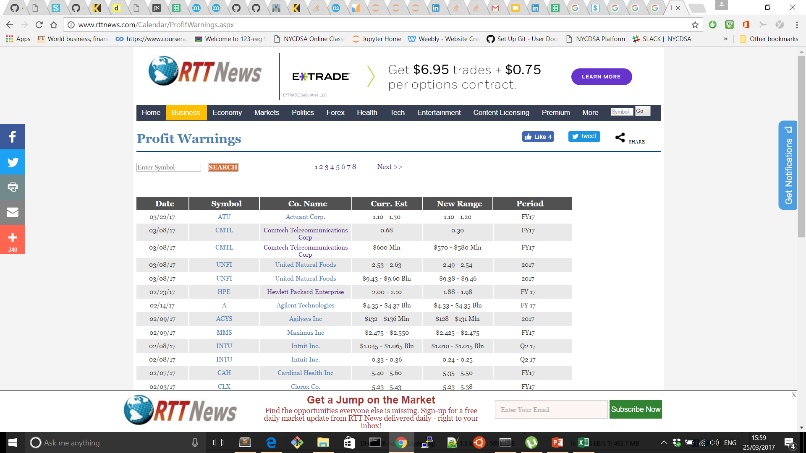
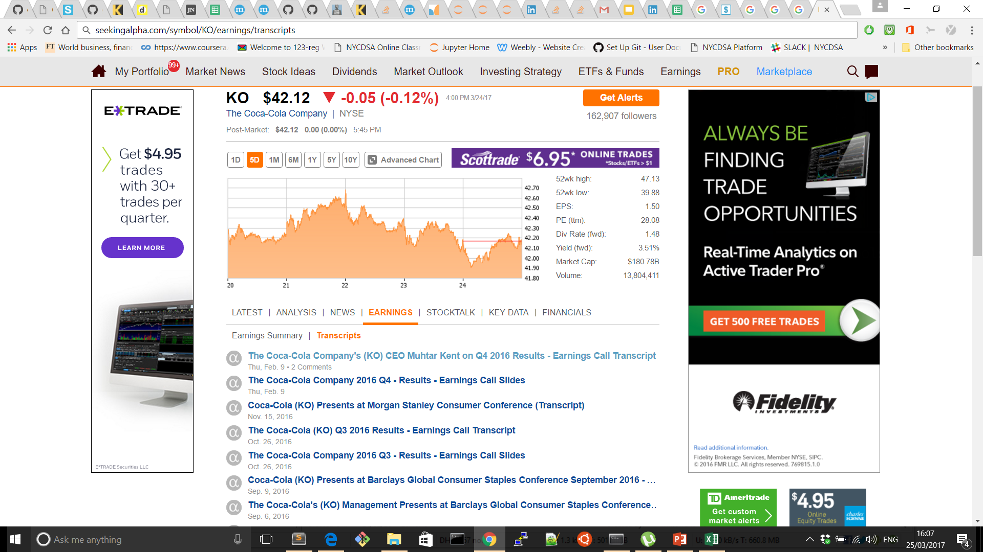
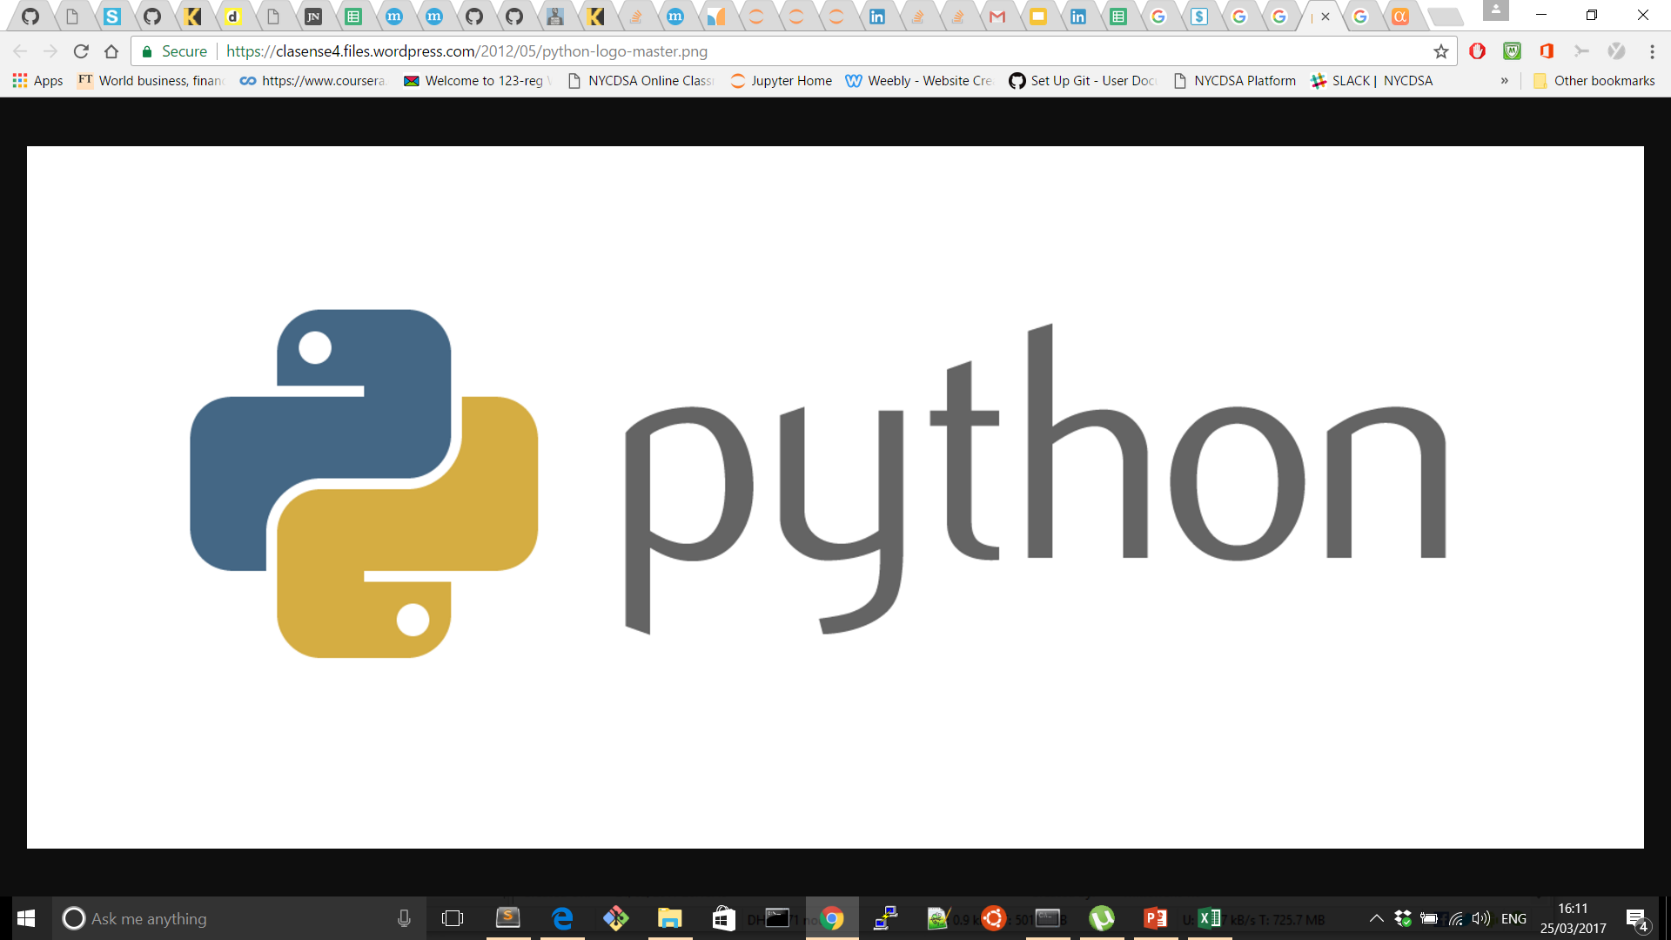


Webscraping: The Quest for Data
http://www.rttnews.com/Calendar/ProfitWarnings.aspx
http://seekingalpha.com/
Profit Warning Stocks Info
Conference Call Transcripts Info
+200 stocks information for 1Q17 and 2016

Slide 9
3. EDA and New Feature Engineering

Slide 10
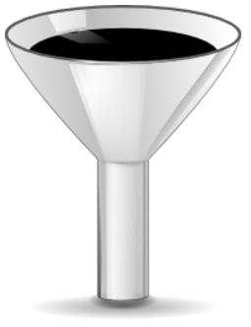
EDA - Feature Engineering
Conference Call Transcripts Information
Management Part
Q&A Part
Size, Word, Sentence, Syllables
Readability Indices: Smog Index, etc.
Number of Difficult words.
Loughran & McDonald Lexicon.
Padding, Polarity, Subjectivity.
Positive vs Negative terms
Uncertainty, Constraint, Litigious terms
Strong, Medium and Weak modal words
Grammatical/Syntax Sentiment Score
Degree Modifiers
+90 New Features

Slide 11
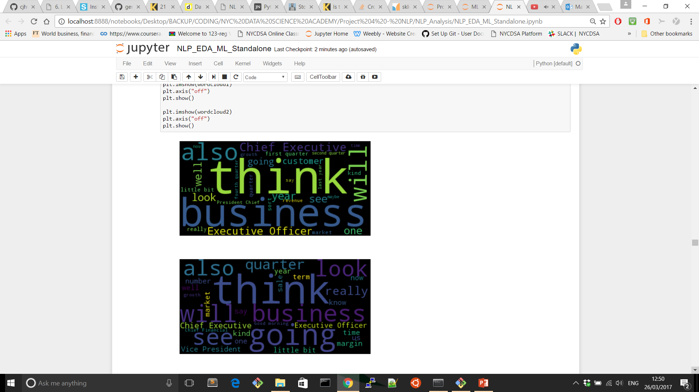
EDA - Word Clouds are not Useful
Profit Warning Companies Word Cloud
Healthy Companies Word Cloud

Slide 12
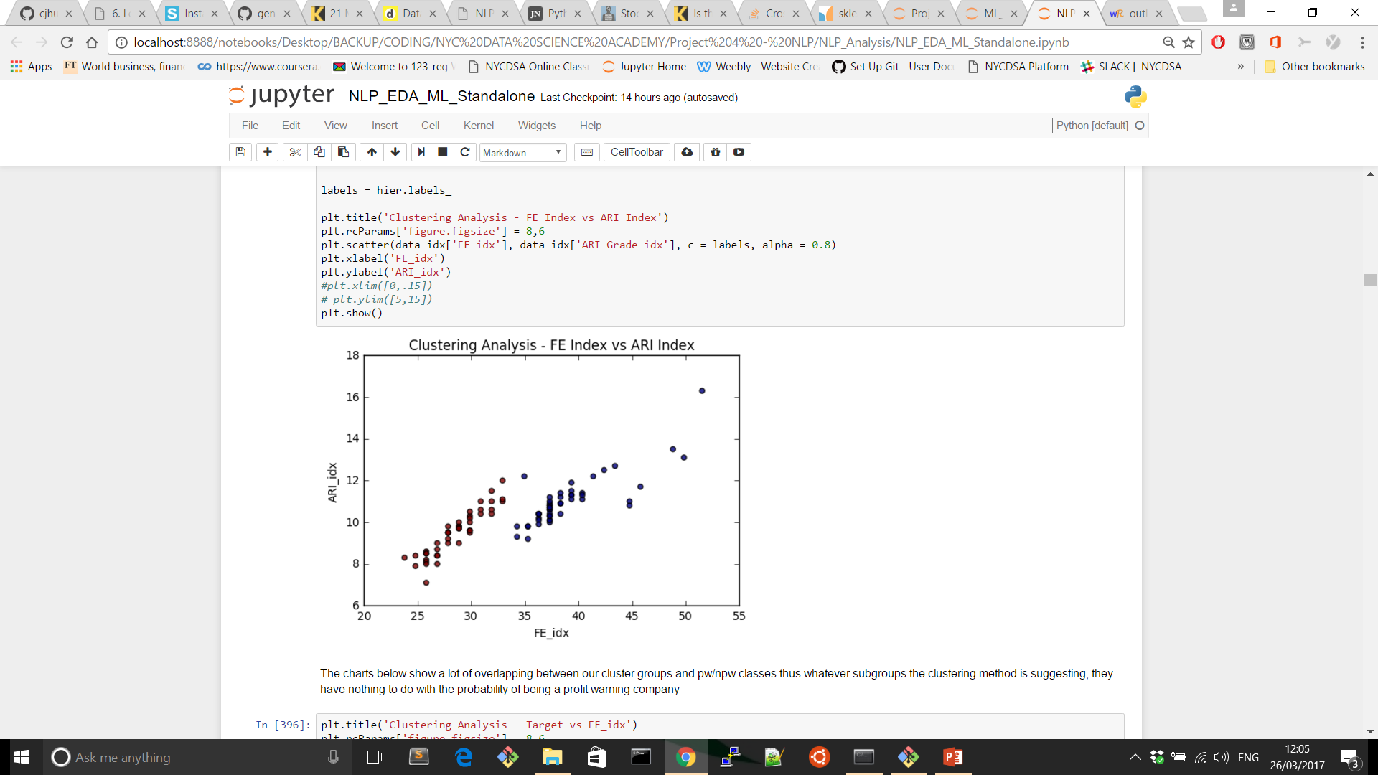
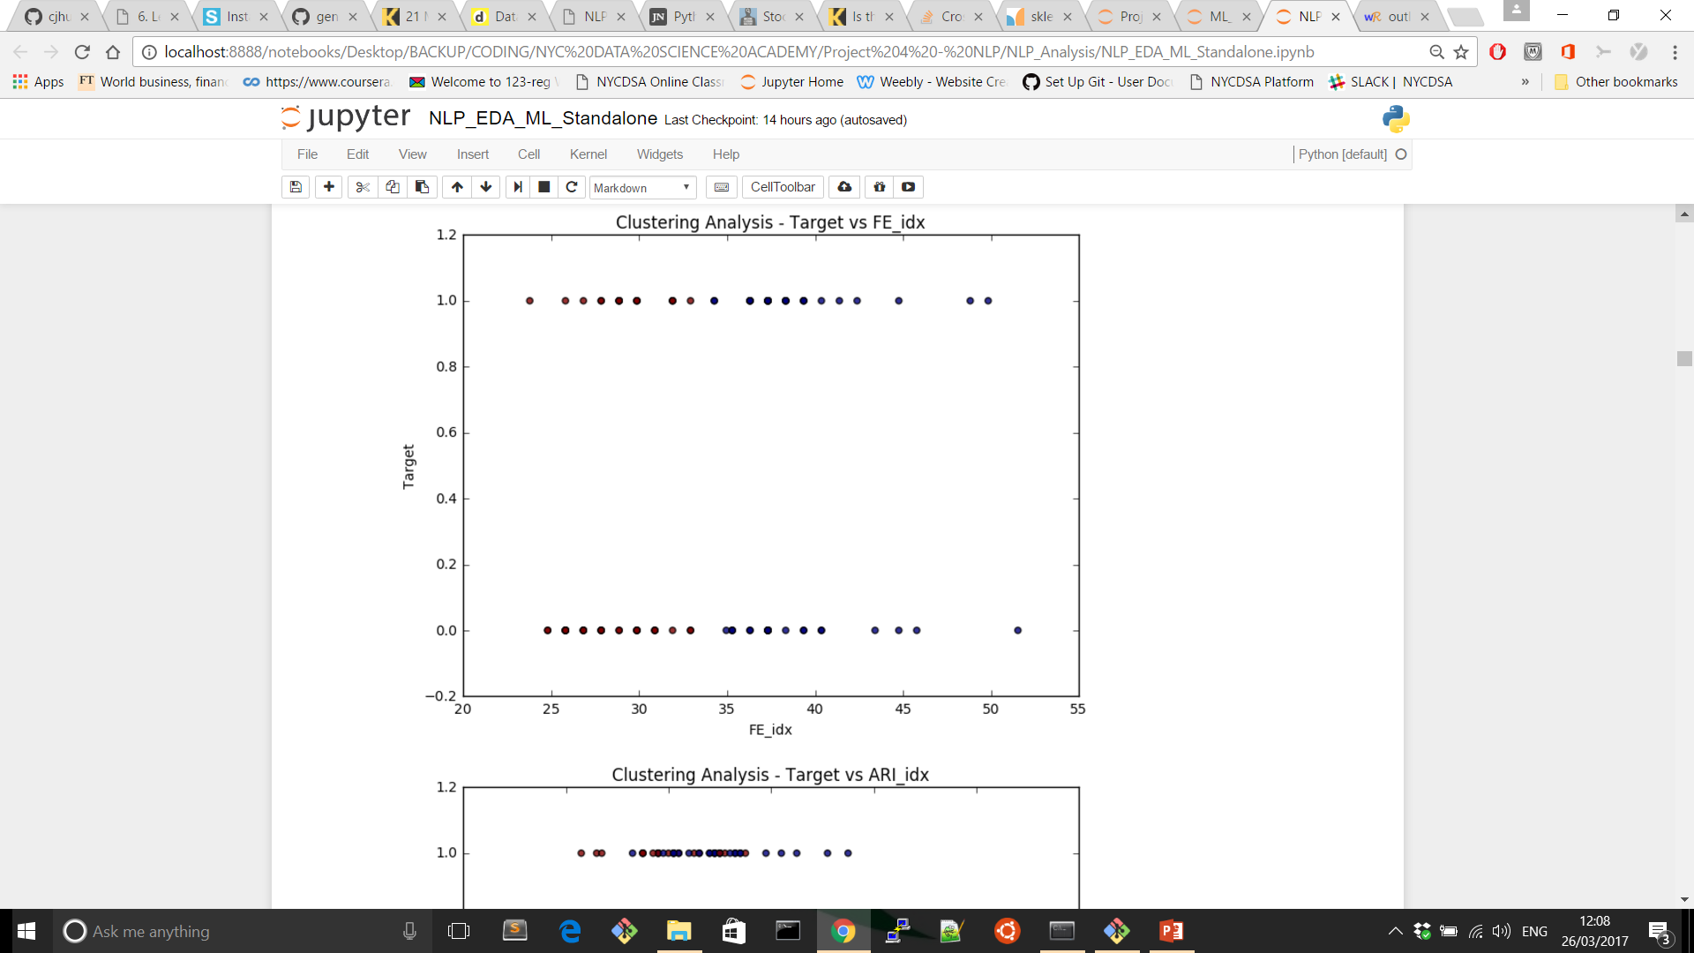
EDA - When Clustering is Misleading
Preliminary Analysis suggests 2 groups
Unfortunately not linked to Profit Warning events.
FE_idx: Flesch Reading Ease (1948). Purpose: DoD materials and Life Insurance docs. Range 0-100 where 90-100 (Very easy) and 0-30 (Very Confusing). The index has been reversed - 0-10 (Very Easy) and 90-100 (Very Difficult) in order to homogenize with all the other indicators.
ARI_idx: Automatic Readability Index (1967): Purpose: General Text Readability Analysis. ARI formula outputs a number which approximates the grade level needed to comprehend the text.
Target: Response Variable. 1 for profit warning companies and 0 for non-profit-warning companies.

Slide 13
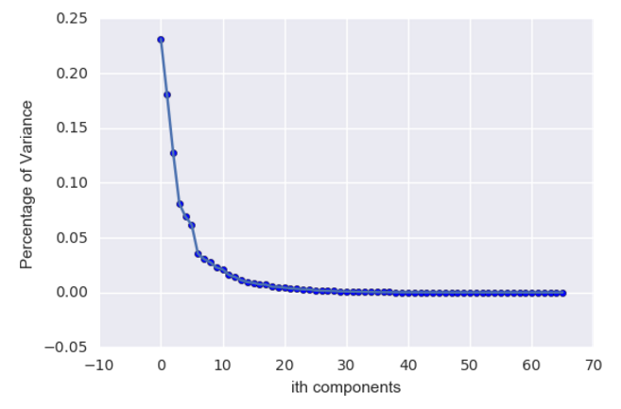
EDA - PCA troubleshoots High Dimensionality
Principal Component Analysis
17 Predictors reduce dramatically model complexity

Slide 14
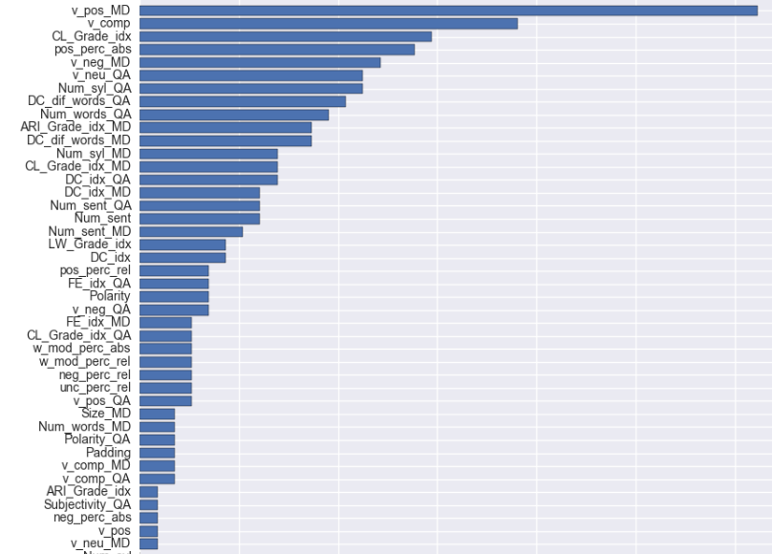
EDA - Feature Engineering
XGB Model – Feature Importance
Percentage of positive sentiment in the management initial speech (v_pos_MD) is a gamechanger.
Overall transcript sentiment score (v_comp) is the second most relevant factor.
Coleman Liau Index (CL_Grade_idx) is the most decisive readability index.
Positive terms (pos_perc_abs) according to Loughran-McDonald financial dictionary play an important role
Particular Q&A session indicators are important: the number of difficult words, syllables and words along with Q&A neutral tone scoring.

Slide 15
4. Machine Learning – Testing Models

Slide 16
Machine Learning - Testing Models Comparison

Slide 17
5. Machine Learning – Ensemble

Slide 18
Machine Learning - Ensemble
Log-Loss
Test Error
Model | Log-Loss
MNB Syn/Sem | 0.6935
BNB Syn/Sem | 0.4605
RF Syn/Sem | 0.6261
XGB Syn/Sem | 0.7924
PCA Logit Text | 0.5802
PCA Logit Syn/Sem | 0.5419
RF Text | 0.5180
RF Total | 0.4202
XGB Total | 0.5544
PCA Logit Total | 0.3587
XGB Text | 0.5277
ENSEMBLE 1:
Total Data
0.3615
0.2103
ENSEMBLE 2:
Min ME & Log-Loss
0.3676
0.1578
ENSEMBLE 3:
Min Log-Loss
0.3775
0.2103

Slide 19
6. Answers & Work in Progress

Slide 20
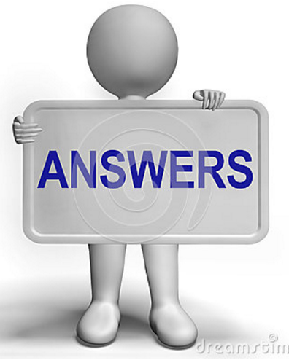
NLP & Profit Warnings – Answers
Are NLP tools useful to help equity research analysts?
Do conference call transcripts contain additional information?
Can we build tools that help flag profit warning risk?
Can we predict Profit Warnings using only NLP tools?
NLP tools help to minimize Behavioural biases
NLP unveils new info embedded into call transcripts
NLP helps to build profit warning risk indicators
NLP usage is more advisable along with other info.
Analysis Outline
Key Information

Slide 21

NLP & Profit Warnings – Work In Progress
Increase number of stocks analysed.
Span the time period studied at least 5 years.
Extend the analysis to other industries and countries.
Tag Management & Analysts Speech separately.
Add Neural Network Model to Ensemble.
Analysis Outline
Key Information

Slide 22
Thanks

